Slide 1
BRAIN TUMOR DETECTION

Slide 2
Outline
Introduction
Project Description
Aims and Objectives
Methodology

Slide 3
Introduction
A brain tumor is a mass or growth of abnormal cells in your brain.
Which, if not identified at an early stage, can lead to death. The brain tumor must thus be detected as early as feasible in order to be treated.

Slide 4
Project Description
It will discuss how to extract and identify brain cancers from a patient's magnetic resonance imaging (MRI) picture. From the Kaggle website, we'll be using MRI Brain Images. A brain tumor region will be detected, with its area and circumference calculated. We propose to apply an anisotropic filter in this project in order to denoise it. In this preprocessing stage, undesirable area noise, such as patient information, is removed from the MRI.

Slide 5
Aims and Objectives
To extract and detect brain tumor region in the MRI images using different methods and we calculate various parameters like area, perimeter of tumor region.
Finding suitable techniques that can do efficient tumor detection with accuracy.
Reduce the work load and minimize the human error while maintaining and improving the accuracy to detect the tumor.

Slide 6
Methodology
Problem identification
Image Acquisition
Preprocessing
Threshold Segmentation
Watershed Segmentation

Slide 7
Methodology Cont..
Morphological Operation
Feature extraction
Area
Perimeter
Image Filling
Eroding
Subtracting
Getting tumor out line

Slide 8
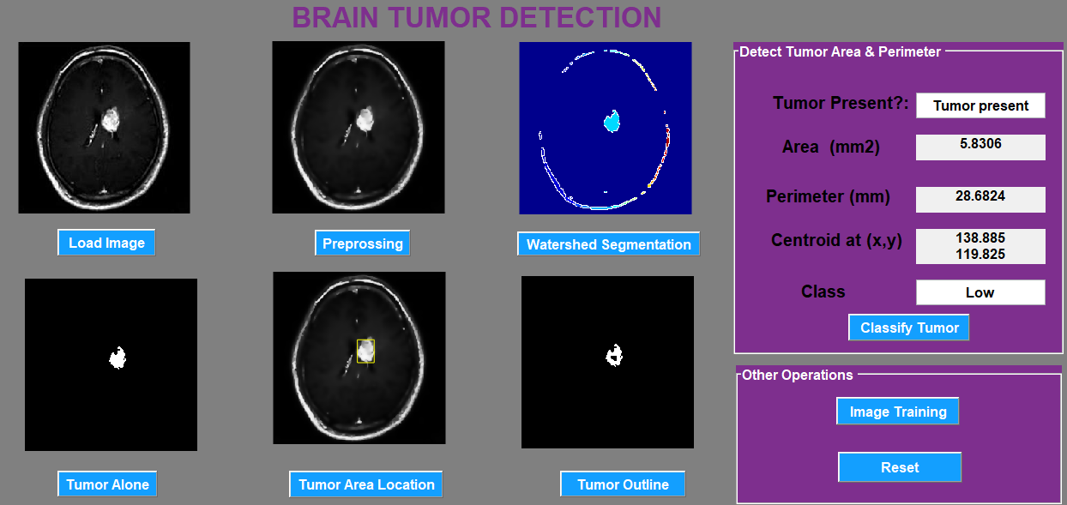
Outputs
Class 1- Low Tumor

Slide 9
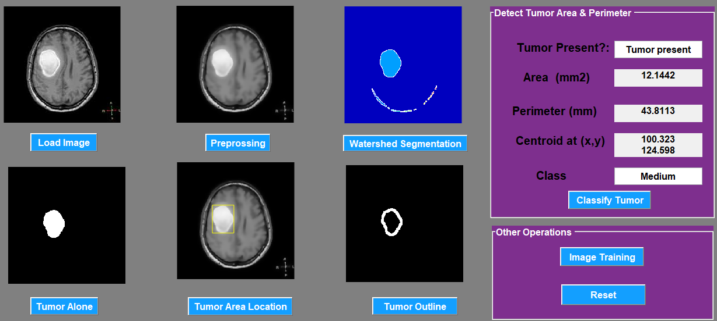
Class2 - Medium Tumor

Slide 10
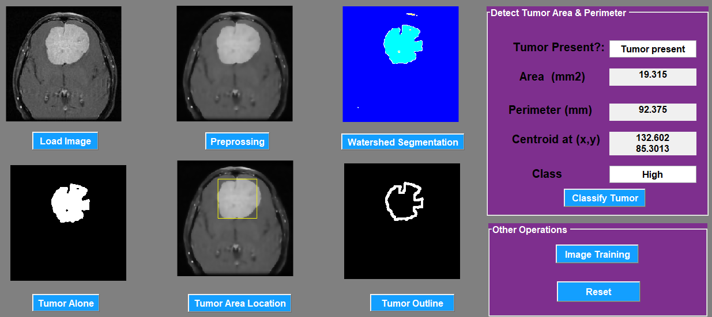
Class3 - High Tumor

Slide 11
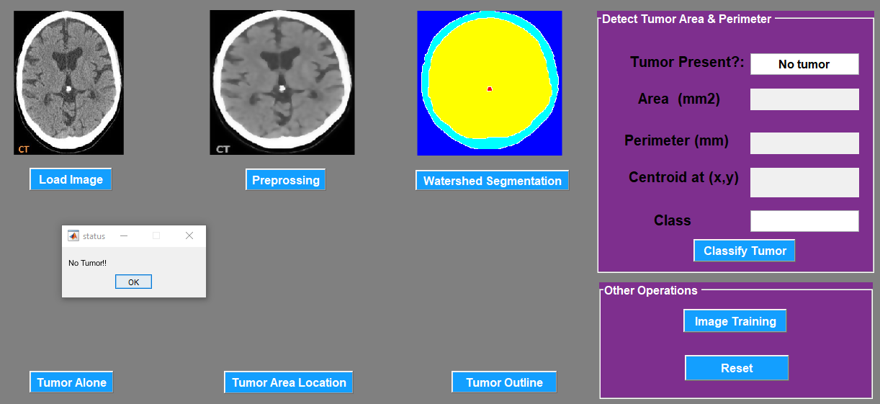
Class4 - NoTumor

Slide 12
THANK YOU

